Slide 1
Dialog MODELS, description languages and notations
Lecture 5

Slide 2
Agenda
Dialog models
  Seeheim Model
  Arch/Slinky Model
  MVC
  PAC Model
Dialog notations
  Single-threaded dialog
  Multiple-threaded dialog
  Concurrent dialog

Slide 3
Dialog models

Slide 4
The Seeheim Model
In 1985 – workshop in Seeheim, West Germany – the first conceptual architecture of a UIMS
describes the user interface as the outer layer of the system = an agent responsible for the actual interaction between the user and the application.
Portability and modifiability are the two architectural drivers of the Seeheim model
Experience shows that the user interface portion of an interactive system is the most frequent source of modifications - the Application Interface Model is a way to preserve the Application from modifications of the user interface.

Slide 5
The Seeheim Model
This conceptualization of the user interface does not include the application semantics (functionality).
the tasks the user can ask the machine to perform are located in another layer, the application interface
Advantages:
  we may provide the same outer layer to different applications ( we may apply the same look and feel to a text editor, a spreadsheet, etc - the user need not learn different dialog languages for different applications)
  we may provide a single application to be implemented behind different outer layers, so as to allow different companies to adopt the same application with their own corporate interface style.

Slide 6
Seeheim model
Allows rapid semantic feedback (by by-passing the dialogue control in some situations)

Slide 7
The Seeheim model
the Application covers the domain-dependent functions and concepts of the system.
The Application Interface Model describes the Application semantics from the viewpoint of the user interface: it describes the data structures and the procedures that the Application exports to the user interface as well as constraints on the procedures sequencing.
The Presentation defines the behavior of the system as perceived and manipulated by the user.
The Dialogue Control - a mediator between the Application Interface Model and the Presentation.
The little box - the possibility for the Application Interface Model to bypass the Dialogue Control in order to improve performance, but it remains the initiator of this one-way direct link.

Slide 8
The Seeheim model - discussion
Seeheim model vs MVC
Seeheim model vs compilers design

Slide 9
The Seeheim Model
The model - a framework for pure functional partitioning that opened the way to a large number of interpretations.
in the mid-eighties, user-system interaction was primarily viewed as a language-based dialogue (very few User Interface Management Systems were based on the event paradigm)
the role of each component was roughly described as the semantic, syntactic and lexical aspects of the interaction, and the overall control structure of the system was assimilated as a pipe-line scheme.
advanced compilation techniques were used to the automatic generation of user interfaces.

Slide 10
The Seeheim model
Direct manipulation – Seeheim model? (interleaving system feedback with user’s inputs)

Slide 11

THE ARCH/SLINKY MODEL
decomposition similar to Seeheim
improvements:
  a clearer identification of the level of abstraction of each component
  an explicit definition of the data structures exchanged between the components
  adaptors between the major components of the structure to improve modifiability and portability
  and the slinky meta-model to balance functions allocation across the system.

Slide 12
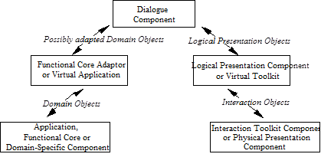
THE ARCH/SLINKY MODEL

Slide 13
THE ARCH/SLINKY MODEL
The Functional Components (The Application in Seeheim)
the Application (also called the Functional Core) covers the domain-dependent concepts and functions
the Interaction Toolkit Component, which is dependent on the actual toolkit used for implementing the look and feel of the interactive system, is in charge of presenting the domain concepts and functions in terms of physical interaction objects (also called widgets and interactors)
the Dialogue Component whose role consists of regulating task-sequencing
model-based user interface generators produce the Dialogue Component from the specification of a task model

Slide 14
THE ARCH/SLINKY MODEL
Data structures
The data structures - transferred between the boundaries: the domain objects, the logical presentation objects and the physical interaction objects
Domain objects are high-level data structures that model domain-dependent concepts (for example, a real number to model the notion of heat)
a domain object is an entity that the designer of the interactive system wishes to make perceivable to, and handled by the user.
Logical presentation objects are abstract entities that convey the presentation of domain objects without being dependent on any particular run time toolkit (a “choice” logical presentation object supports the rendering as well as the manipulation of a multi-valued domain object)
The concrete rendering of a domain object results from the mapping of the logical presentation object to a physical interaction object (the choice logical presentation object can be mapped to the physical pull-down menu of a graphical toolkit)

Slide 15
THE ARCH/SLINKY MODEL
The Arch adaptors: the Functional Core Adaptor and the Logical Presentation Adaptor
the major functional components of an interactive system the Application, the Dialogue and the Presentation, do not exchange data directly.
they mediate through adaptors: the Functional Core Adaptor and the Logical Presentation Component.
The Functional Core Adaptor (FCA) is intended to accommodate various forms of mismatch between the Functional Core and the user interface of the system
the FCA can be understood as the virtual application layer

Slide 16
THE ARCH/SLINKY MODEL
data transfer through the FCA is performed in terms of domain objects
domain objects match the user’s mental representation of a particular domain concept.
the Functional Core, driven by software or hardware considerations, implements a domain concept in a way that is not adequate for the user
domain objects of the functional core may need to be adapted
the Functional Core and the user interface may be implemented with different formalisms

Slide 17
THE ARCH/SLINKY MODEL
the Logical Presentation Component - insulates the rendering of domain objects from the actual interaction toolkit of the target platform.
It is expressed in terms of the logical presentation objects provided by a virtual toolkit
switching to a different physical interaction toolkit requires rewriting mapping rules, but the logical presentation objects remain unchanged
AWT (Geary, 1997) and XVT (Rochkind, 1989) are examples of virtual toolkits: they embed the mapping of the logical widgets to the physical widgets of the target machine.
multi-platform toolkits such as Java Swing (Geary, 1999) and Ilog Views (Ilog, 1994) tend to alleviate this problem by re-implementing native toolkits behavior for multiple target machines (it is possible to obtain a Windows look and feel on a Macintosh platform)

Slide 18
THE ARCH/SLINKY MODEL
When efficiency prevails against toolkit portability, then the Logical Presentation Component can be eliminated and the presentation level of the interactive system is directly expressed in a native toolkit
If, the Functional Core provides an "interface" that conforms to the user's requirements, and if it will not evolve in the future, then the Functional Core Adaptor can be scaled down to a simple connector (e.g., a set of procedure calls).

Slide 19
AGENT-BASED MODELS
Agent-based models structure an interactive system as a collection of computational units called agents
An agent has a state, possesses an expertise, and is capable of initiating and reacting to events.
Agents that communicate directly with the user are sometimes called interactors or interaction objects.
An interactor provides the user with a perceptual representation of its internal state.
Seeheim and Arch structure a complete interactive system as three fundamental functions (Functional Core, Dialogue, and Presentation)
agent-models structure an interactive system as a collection of cooperating agents where every agent is a mini-Seeheim-like structure

Slide 20
MVC
In MVC (Model, View Controller), an agent is modeled along three functional perspectives: the Model, the View, and the Controller.
A Model defines the abstract competence of the agent (i.e., its functional core).
The View defines the perceivable behavior of the agent for output.
The Controller denotes the perceivable behavior of the agent for inputs.
The View and the Controller cover the user interface of the agent, that is, its overall perceivable behavior with regard to the user

Slide 21
MVC
An agent is instantiated by connectors between a Model, a View and a Controller.
Connectors are implemented as method invocation and anonymous callbacks.
the Controller translates the user’s actions into method calls on the Model.
The Model broadcasts a notification to the View and the Controller that its state has changed.
The View queries the Model to determine the exact change and upon reception of a response, updates the display accordingly

Slide 22
PAC (Presentation, Abstraction, Control)
an agent has:
  a Presentation (i.e., its perceivable input and output behavior),
  an Abstraction (i.e., its functional core), and
  a Control to express multiple forms of dependencies.
The Control of an agent is in charge of communicating with other agents as well as of expressing dependencies between the Abstraction and the Presentation facets of the agent
dependencies of any sort are conveyed via Controls -the glue mechanism to express coordination as well as formalism transformations between the abstract and the concrete perspectives

Slide 23
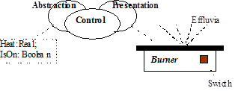
PAC Example
The Presentation of the agent is in charge of drawing the picture of a burner as well as of interpreting user’s actions.
User’s actions include dragging the burner around with the mouse or clicking the switch to turn the burner on or off.
A mouse click on the switch has the following effects: the Presentation of the agent updates the rendering of the swicth to express that the burner is on or off, then sends a notification to the Control.
the Control which maintains the dependencies between the switch and the IsOn boolean variable, notifies the Abstraction facet of a change for IsOn.
The Abstraction, the functional core of the burner agent, computes the heat according to the laws of thermodynamics.
As the heat crosses a threshold, the Abstraction notifies the Control of the fact.
the Control, which maintains the dependencies between the threshold values and the height of effluvia, notifies the Presentation that effluvia should be redrawn.
The Presentation changes the rendering of the effluvia accordingly.

Slide 24
Dialog notations

Slide 25
The interaction (dialogue)
Dialogue = symbols transfer at interface level
Characteristics:
  Style
    Command language
    Menus
    Form filling
    Direct manipulation
    Natural language
    Intelligent interfaces
Evaluation criteria:
  Task performance
  Errors
  Learning time
  Knowledge persistence
  Subjective satisfaction
  Structure – formal description of dialog elements and occurrence order
  Content – semantic of exchanged information

Slide 26
The Dialog
Conversation between multiple partners
  Usually cooperative
User interfaces:
  Refers to interaction structure
  Sintactical level of interaction
Seeheim model:
  Lexical – icons, key press
  Syntactical – input/output sequences
  Semantic – the effect on internal data/ processes that manipulates the data

Slide 27
The Dialog
Close relation to:
  System semantic (WHAT IT DOES)
  System presentation (HOW IT LOOKS)
Formal description – analysis could identify:
  Inconsistencies
  Irreversible actions
  Lack of needed actions
  Potential errors

Slide 28
Dialog notations
Usually, the dialog “gets lost” in the system
Complex system:
  Dialog analysis (ex: do the user always sees the shopping cart?)
  Lexical/syntactic analysis of the system
  Compare different design proposals
Notations:
  Diagrammatic: state-transition diagrams, statecharts, Petri nets, JSD diagrams, flow diagrams
  Textual: grammars, CSP, event handlers

Slide 29
Dialog formal specification approaches
Requirements:
  Precise description of interface behavior
  Lack of implementation constraints
Classification:
  Single threaded dialog
    Transition networks, context independent grammars
  Multiple-threaded dialog
    Events, statecharts
  Concurrent dialogs
    Process algebra, Petri nets

Slide 30

State-transition Networks
User action
transition
state
System action
2: record first point
3: draw line to current position
4: record second point
Advantage: natural description, executable
Formal: modified automaton STN= (Q, Σ, P, δ, γ, q₀, f)
      P – set of system actions
      γ : Q → P – action function
Improvements: recursivity

Slide 31
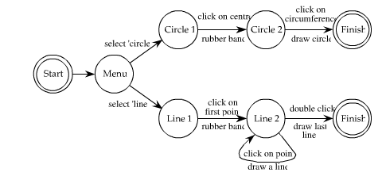
State-transition Network
User action
System action
Double click???
Errors cannot be described in state-transition networks…

Slide 32
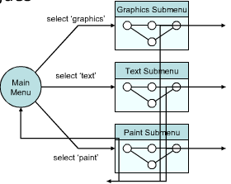
Complex systems…

Slide 33
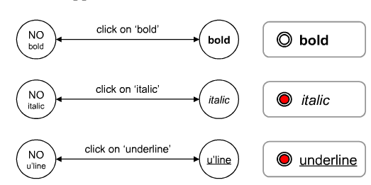
Concurrent dialogues

Slide 34
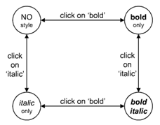
Bold & italic

Slide 35
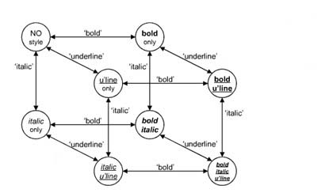
Bold, italic & underline
Combinatorial state explosion

Slide 36
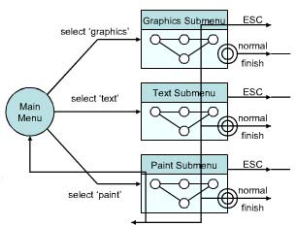
Forced exit
“back” behavior (web), escape or cancel in desktop application – similar behavior – “Spaghetti” of identical behaviors”
  Spaghetti code
  Lasagna code
  Spaghetti with meatballs code
How to avoid ? –normal exit for each submenu and ESC action available in each submenu

Slide 37
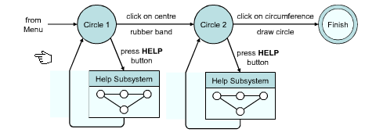
Help menu
Similar to back/cancel, but we return to the same state
The diagram becomes very crowded
Recommended to be specified at a metalevel

Slide 38
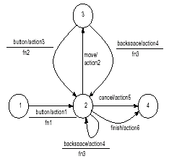
Augmented Transition Networks(ATN)
User action/system action
Set of transition diagrams
registries
  Arbitrary values visible only in dialog component attached to diagrams
  Computations are performed on the registry values in order to decide if a transition will be performed
    TRUE – the transition executes
    FALSE – the transition doesn’t execute
Formal description: push-down automaton
M = (Q, Σ, P, Γ, δ, γ, q₀, Z₀, f)
P – set of system actions
γ : Q → P – action function
function
action 1 : record first point
action 2 : draw line to current position
action 3 : record next point
action 4 : delete last point;
action 5 : delete polyline;
action 6 : return polyline
fn1 :count :=1; return (true) ;
fn2 :count :=count+1 ; return (true) ;
fn3 :if (count =1) then return (false)
else count:=count+-11;
return (true).

Slide 39
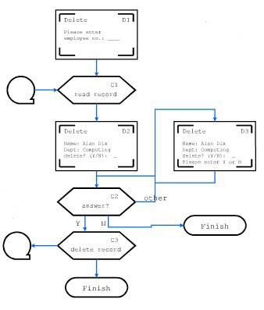
Flow diagrams
Familiar to programmers
Boxes represent processes and events
Used to describe dialogs, not algorithms
Could be used in discussions with clients, converted to code and afterwards tested - efficiency

Slide 40





Flow diagrams symbols
Begin/end action
Operation
Result (report, document)
Decision
Information that enter/exit process

Slide 41



Flow diagrams symbols
Continue on the same page
Continue on another page
Delay
Order/direction

Slide 42
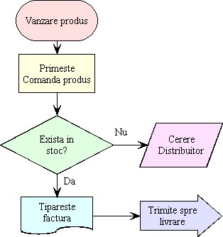
Flow diagram - example

Slide 43
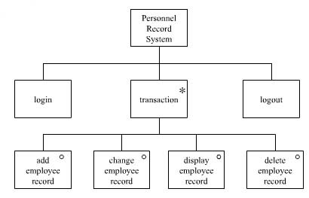
JSD Diagrams (Jackson Structured Diagram)
Used for tree-like dialog structure
Increased clarity, reduced expressivity
“o” – choosing between multiple options
“*” - iteration
iteration
selection

Slide 44
Context Independent Grammars
motivation: human dialog described by grammars
Syntactical analysis: top-down, bottom-up
L(G) –all acceptable user actions
Formal description:
  G= (N, Σ, R, P, S),
  R – finite set of symbols – actions associated to productions
  P – productions sets
  n → γrα n∈N, γ,α∈(NUΣ)*, r∈R ;
Line → button End_point
End_point → move End_point | button.
line → button d1 end_point
end_point → move d2 end_point | button d3
d1 → {record first point}
d2 → {draw line to current position}
d3 → {record second point}.
Only user actions are represented
System actions should be attached to productions

Slide 45
Dialog specification notation classification
  Single-threaded dialog
    Transition networks, CIG context
  Multi-threaded dialog notations
    Events, statecharts
  Concurrent dialog
    Process algebra, Petri nets

Slide 46
Events
Event handlers
Template: parameters, procedures, local variables, handled events
UI = set of event handlers templates
Events sources: presentation level and event handlers
Formal description: EH = (m, r, Q, R, P),
  m – the number of event types processed by the event handler
  r – the number of registers from handler (m<=r);
  Q – event queue, Q∈E*;
  R– set of regitry values for EH;
  P – set of m procedures for EH, one procedure for each event type that can be processed by the handler
configuration: (q, ρ),q –event queue, ρ - registry values

Slide 47
Events
EVENT HANDLER line
TOKEN
button Button
move Move
VAR
int state ;
point first, last;
EVENT Button DO{
IF state==0 THEN
first = current position;
state = 1;
ELSE
last = current position;
deactivate(self);
ENDIF;
}
EVENT Move DO{
IF state==1 THEN draw line from
first to current position;
ENDIF
}
INIT
state = 0;
END EVENT HANDLER line;

Slide 48
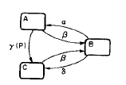
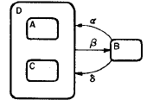
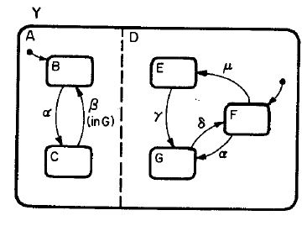
Statecharts
Clusterization, states refinement; independency, concurrency; transition between abstraction levels
Transition diagrams extension with AND & XOR
state
event
condition
transition
AND
XOR

Slide 49
Dialog specification notation classification
  Single-threaded dialog
    Transition networks, CIG context
  Multi-threaded dialog notations
    Events, statecharts
  Concurrent dialog
    Process algebra, Petri nets

Slide 50
Process algebra
Agent = entity that models and describes a specific part of a system
  Internal actions
  Communication actions
P – set of agents, denoted by P, Q, R
X – set of agent variables, denoted by x, y;
N - set of communication channels names (a, b, c) ;
L – set of communication channels labels ; L ={a,ā | a ∈N}
Inactive agent 0 – completed process
Prefix operator “.”: α.P
transition relation
P
P’

Slide 51
Process algebra (2)
Prefix α.P | Prefix
Parallel composition (P|Q) | Com1
 | Com2
 | Com3
Restriction (P\L) | Res
Sum (P+Q) | Sum

Slide 52
Process algebra(3)
Agent behavior= equation
A = b.B + c.C – agent A may execute action b and behaves like agent B or may execute action c and behaves like agent C
Describes actions synchronization, but can not be used to describe real systems
improvement: values transfer: ā(v).P – send value v on channel a, than start to execute P

Slide 53
Petri Nets
transition
<P, T, Pre, Post, M>
  P set of locations
  T set of transitions
  Pre : P x T → N
  Post : T x P → N
  M : P → N
Object
T1
Object
Method1
Method2
Method3
M
Method1
Method2
Method3
2
T2
P1
<x>
<y>
z=x.Metthod1(y)
P2
2
T4
<z>
<x>
<y>
Can not be used to model problem domain Petri nets with objects
T1
T3
P3
Pre
T2
T3
Post
location
T4
http://www.informatik.uni-hamburg.de/TGI/PetriNets/introductions/aalst/trafficlight1.swf

Slide 54
Petri nets in objects
Object
ICO
(Interactive Cooperative Objects)
  data
    Objects attributes
  operations
    Spontaneous object operations+services
    Objects communication: C-S
  behavior (ObCS = PN)
    Describes services availability, the way services requests are processed, services that are required by other objects
    Each service has associated transitions from ObCS
  presentation
    Structured set of widgets
    Activation function: (widget, user action)→ service
Advantages: solid formal fundamentals, executability, graphical representation, model formal verificationr
Object
Object
Method
Method
Method

Slide 55
Dialog analysis
Tangibility
  Can we reach the desired state from current state?
Reversibility
  Can we reach the previous state?
Dangerous states avoidance
  Difficult to ensure

